Slide 1
The Language of RNA: A Formal Grammar That
Includes Pseudoknots
Elena Rivas and Sean R. Eddy
Department of Genetics, Washington University, St. Louis, MO 63110, USA
BIOINFORMATICS
Vol. 16 no. 4 2000 Pages 334–340
Date: Jan. 9, 2008
Speaker: Chia-Hung Chang

Slide 2
Abstract
Motivation: In a previous paper, we presented a polynomial time dynamic programming algorithm for predicting optimal RNA secondary structure including pseudoknots. However, a formal grammatical representation for RNA secondary structure with pseudoknots was still lacking.

Slide 3
Results: Here we show a one-to-one correspondence between that algorithm and a formal transformational grammar. This grammar class encompasses the context-free grammars and goes beyond to generate pseudoknotted structures. The pseudoknot grammar avoids the use of general context-sensitive rules by introducing a small number of auxiliary symbols used to reorder the strings generated by an otherwise context-free grammar. This formal representation of the residue correlations in RNA structure is important because it means we can build full probabilistic models of RNA secondary structure, including pseudoknots, and use them to optimally parse sequences in polynomial time.

Slide 4
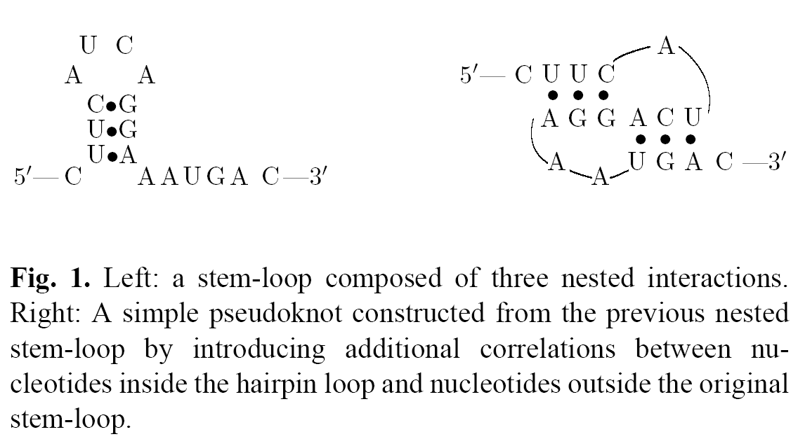
Pseudoknot

Slide 5
Input & output
Input
  An RNA sequence
Output
  The language – RNA sequence with its structure

Slide 6
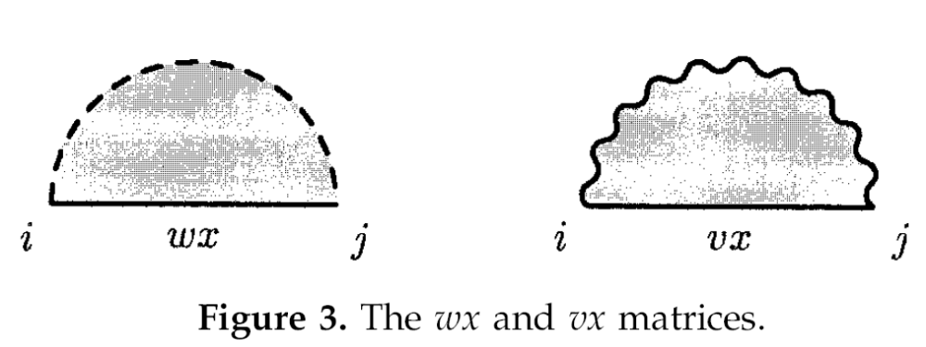
Recall the previous paper

Slide 7
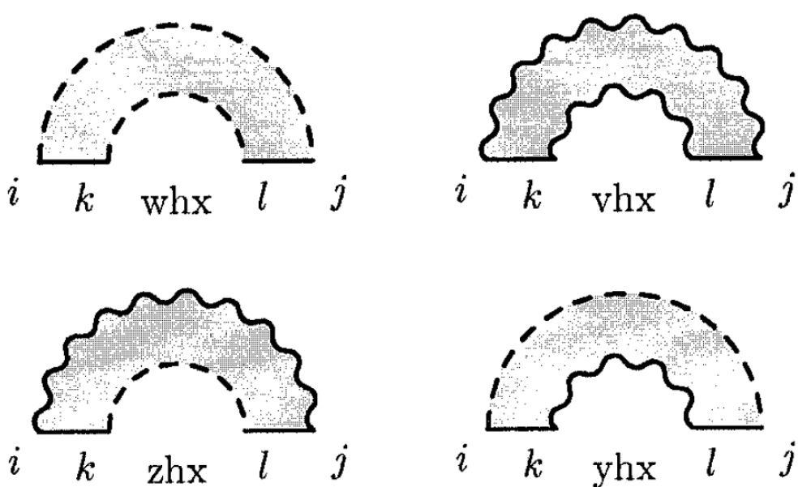

Slide 8
The grammar
Components:
  G = { V, T, S, I, P, R }
  V = finite set of nonterminal symbols
  T = finite set of terminal symbols
  T* = { T } U { є } U { Λ }
  S = the start nonterminal
  I = finite set of extra nonterminal symbols
  P = finite set of productions
  R = finite set of rearrangement rules

Slide 9
A simple example – copy-language grammar
T = { a, b }, V = { W, W_{H} }
L = {ε, wΛw | w ∈ (a, b)* }
I = { (, ), X }
Production rules:
  W → WW | (W_{H} × W_{H}) | ε
  W_{H} → a ∧ a | b ∧ b | (W_{H} × W_{H}) | ∧
Rearrangement rules:

Slide 10
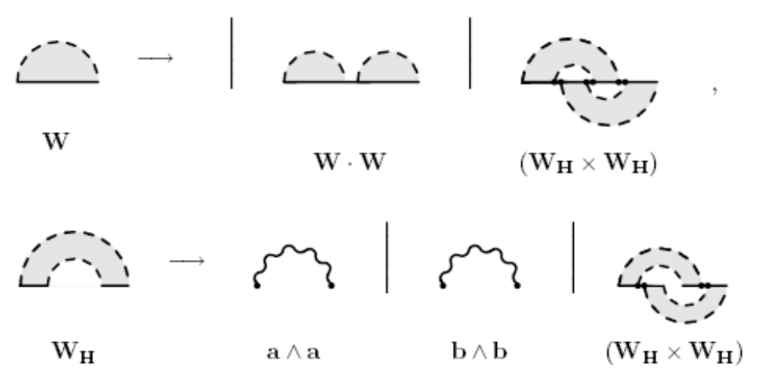

Slide 11
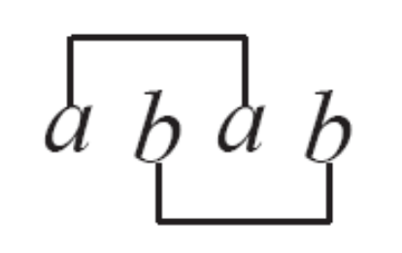
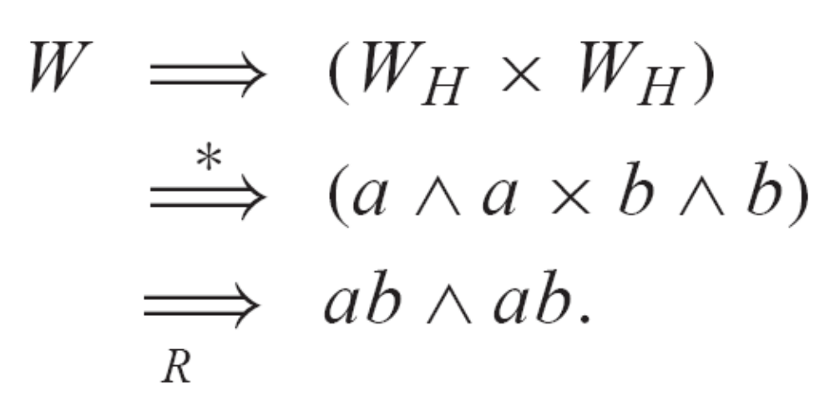
A toy ‘knotted’ sequence

Slide 12
RNA pseudoknot grammar
Nonterminals
  V = { W, W_{B}, V^{ab}, W_{H}, V^{abcd}_{H} , IS1, IS2 }.
RNA alphabet
  T_{RNA} = { a, c, g, u }
Extra symbol
  I = { (, ), X, X_{L}, X_{R}, ⊃ }
  Nonterminals specific for pseudoknots

Slide 13
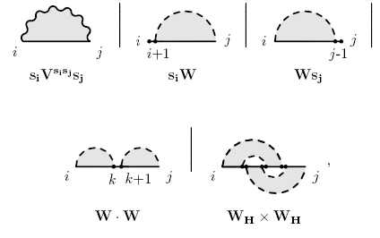
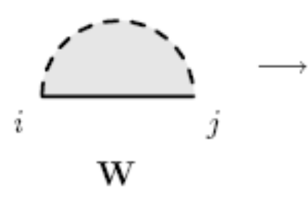
Production rules

Slide 14
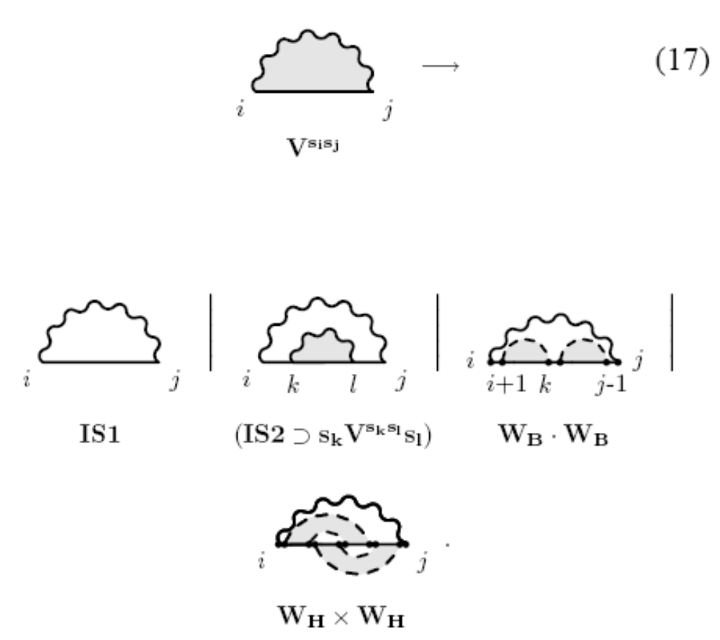

Slide 15
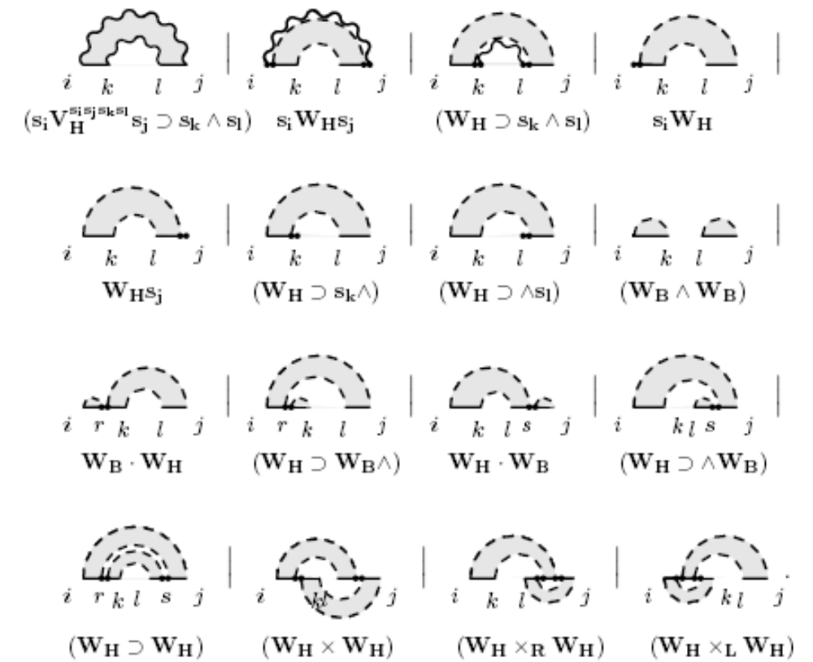
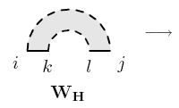

Slide 16
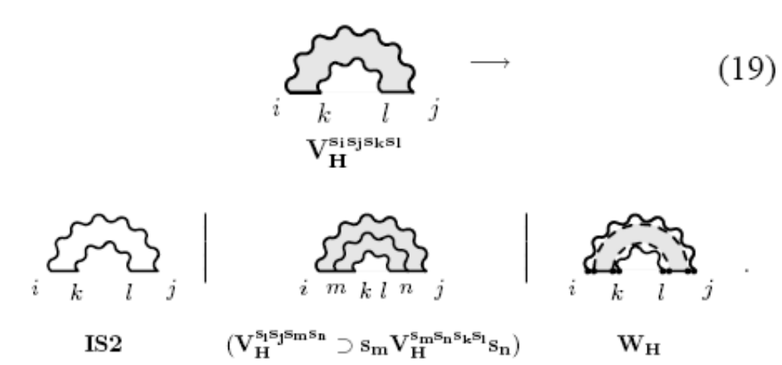

Slide 17
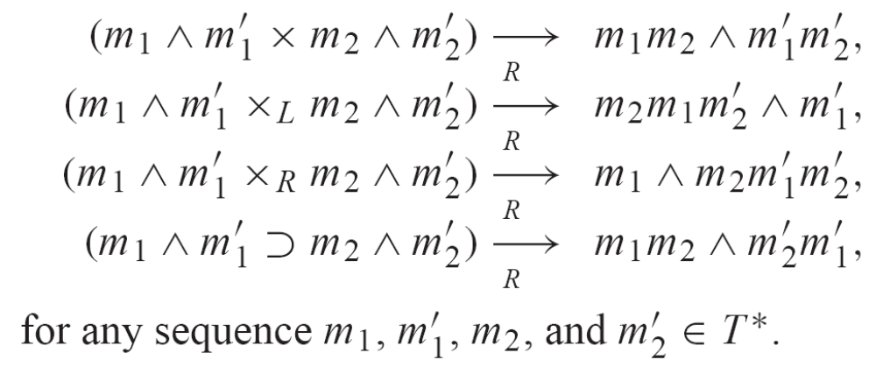
Rearrangement rules

Slide 18
Conclusion
It’s ambiguous.
It’s a non-stochastic form using free energy.
With a formal pseudoknot grammar in hand, it will be easy to produce a stochastic version.

